Slide 1
OpenStreetMap
Guest appearance from Noise-Planet
Presentation for the Spatial Literacy User Group
Mairead.deroiste@vuw.ac.nz

Slide 2
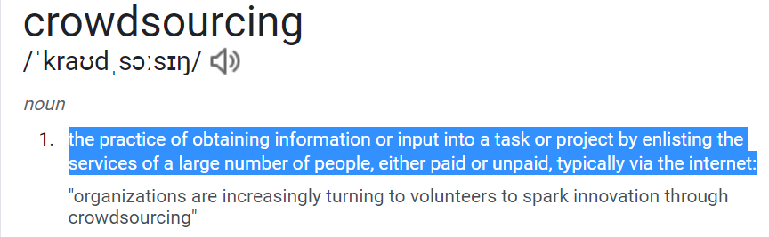
https://languages.oup.com/
Notes:
https://nz.search.yahoo.com/search?fr=mcafee&type=E210NZ885G0&p=what+is+crowdsourcing

Slide 3
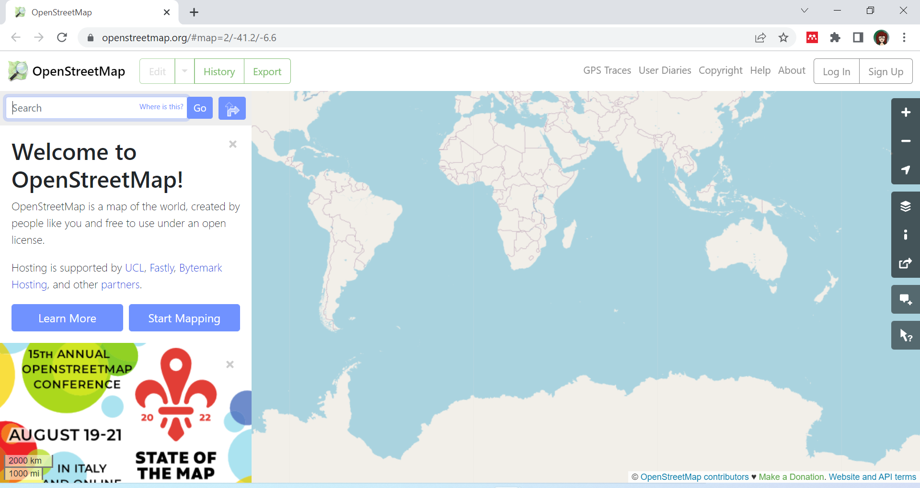

Slide 4
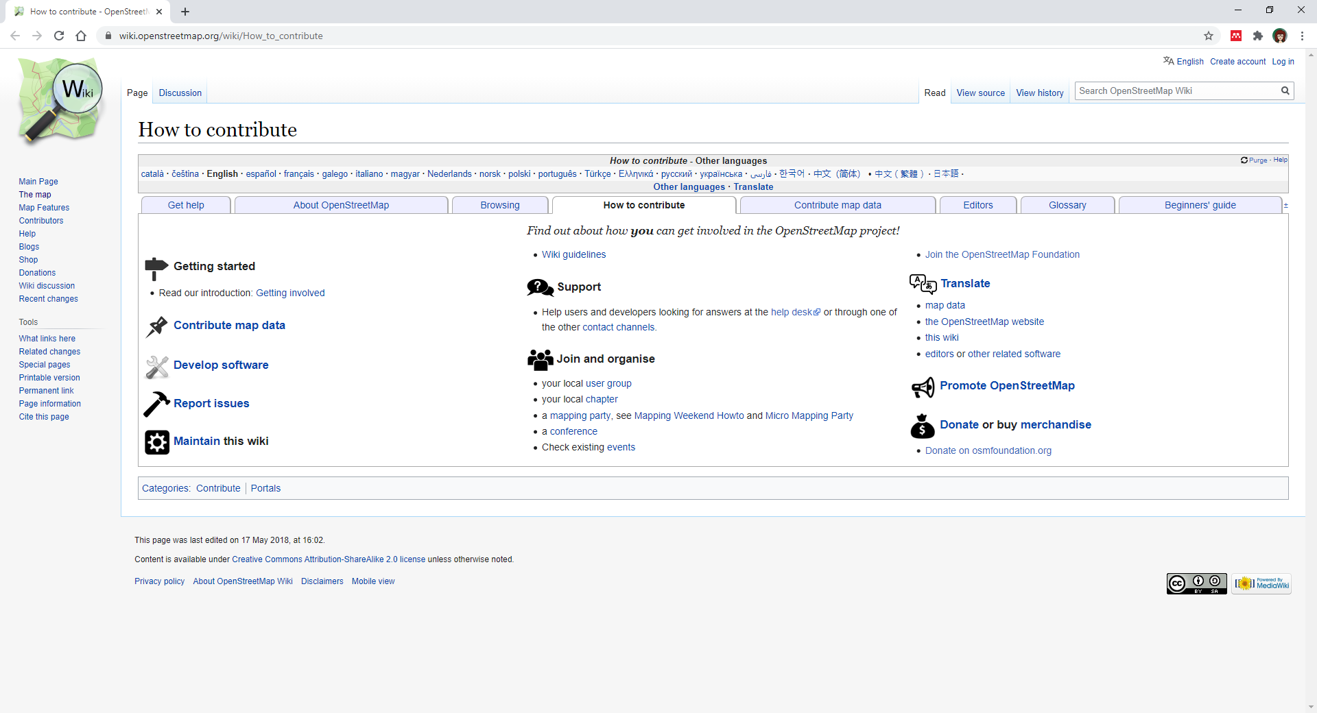

Slide 5
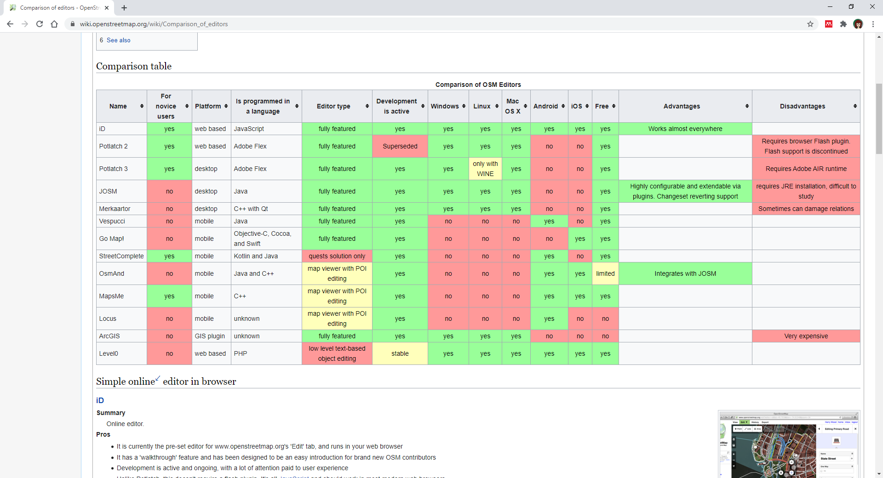

Slide 6
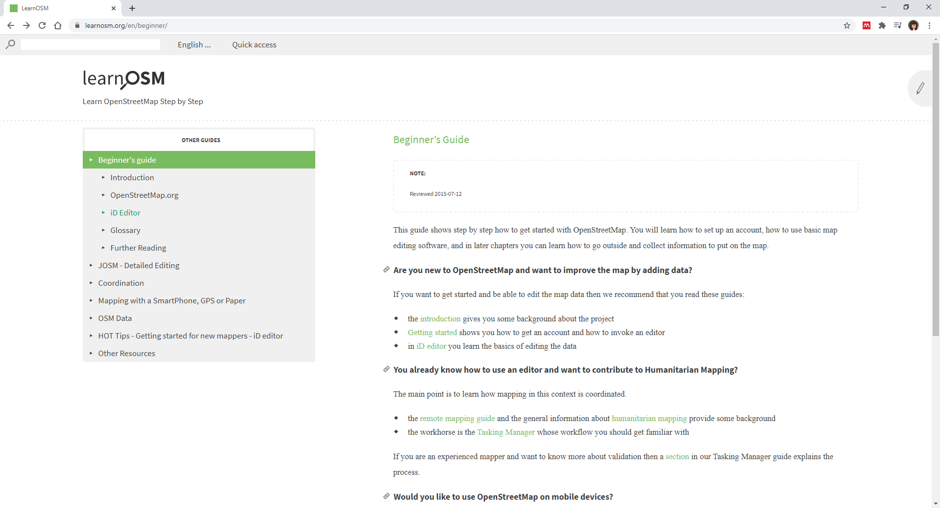

Slide 7
Quality of the dataset for Use
Accuracy | Is the information correct in every detail?
Completeness | How comprehensive is the information?
Reliability | Does the information contradict other trusted resources?
Relevance | Do you really need this information?
Timeliness | How up- to-date is information? Can it be used for real-time reporting?
https://www.precisely.com/blog/data-quality/5-characteristics-of-data-quality

Slide 8
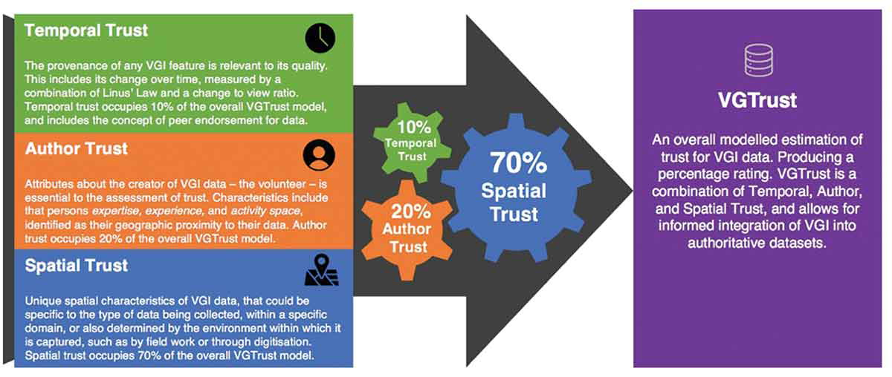
Jeremy Severinsen, Mairead de Roiste, Femke Reitsma & Emir Hartato (2019) VGTrust: measuring trust for volunteered geographic information, International Journal of Geographical Information Science, 33:8, 1683-1701, DOI: 10.1080/13658816.2019.1572893

Slide 9
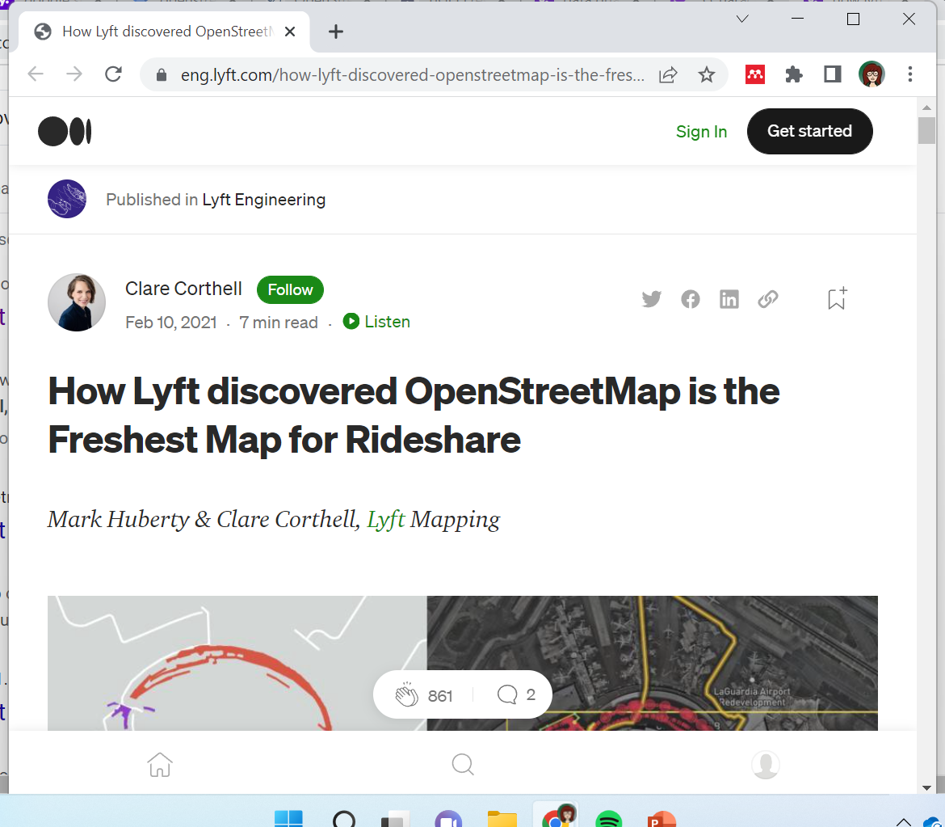
https://eng.lyft.com/how-lyft-discovered-openstreetmap-is-the-freshest-map-for-rideshare-a7a41bf92ec

Slide 10

https://eng.lyft.com/how-lyft-discovered-
openstreetmap-is-the-freshest-map-for-
rideshare-a7a41bf92ec
After 16 years of growth, OSM is now commonly used by many companies to power applications like logistics platforms, social media, and gaming.
OSM is now the biggest crowdsourced repository of human geospatial knowledge.
But is this map suitable for supporting the rideshare experience? Is it the best option available? Can Lyft support the OSM community and contribute to making the map better?

Slide 11
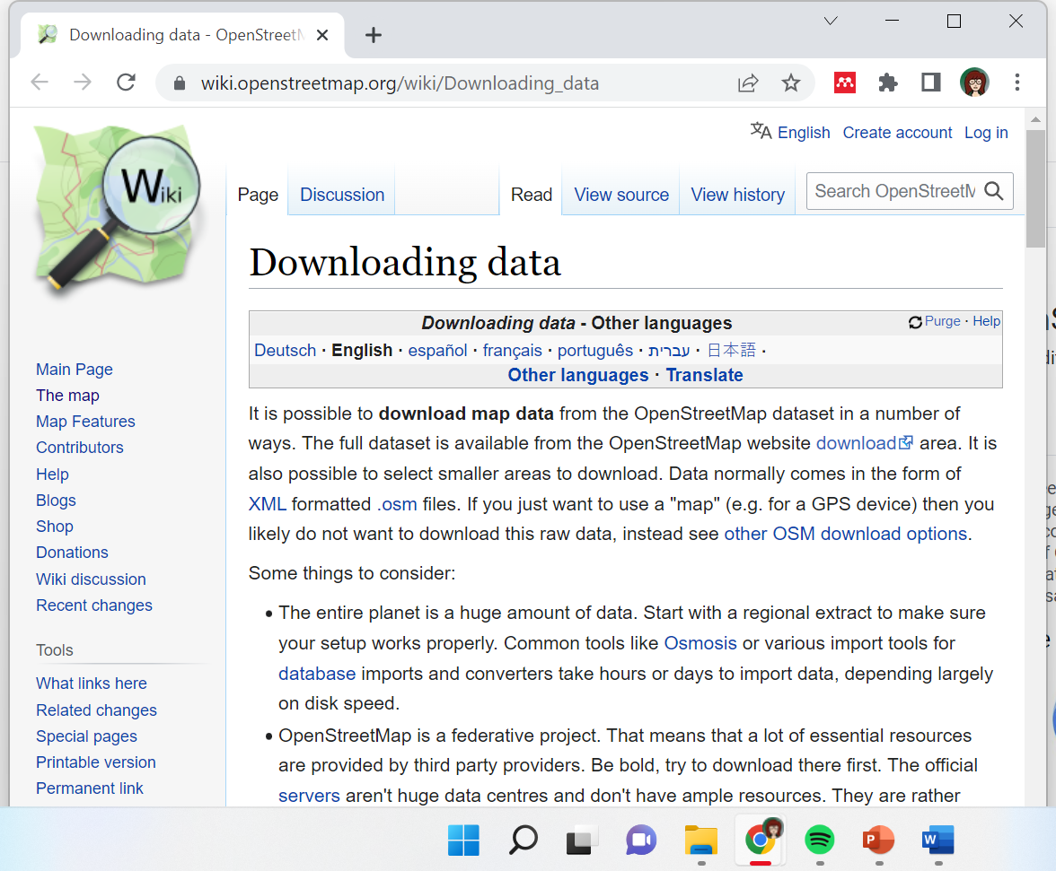
How to download

Slide 12
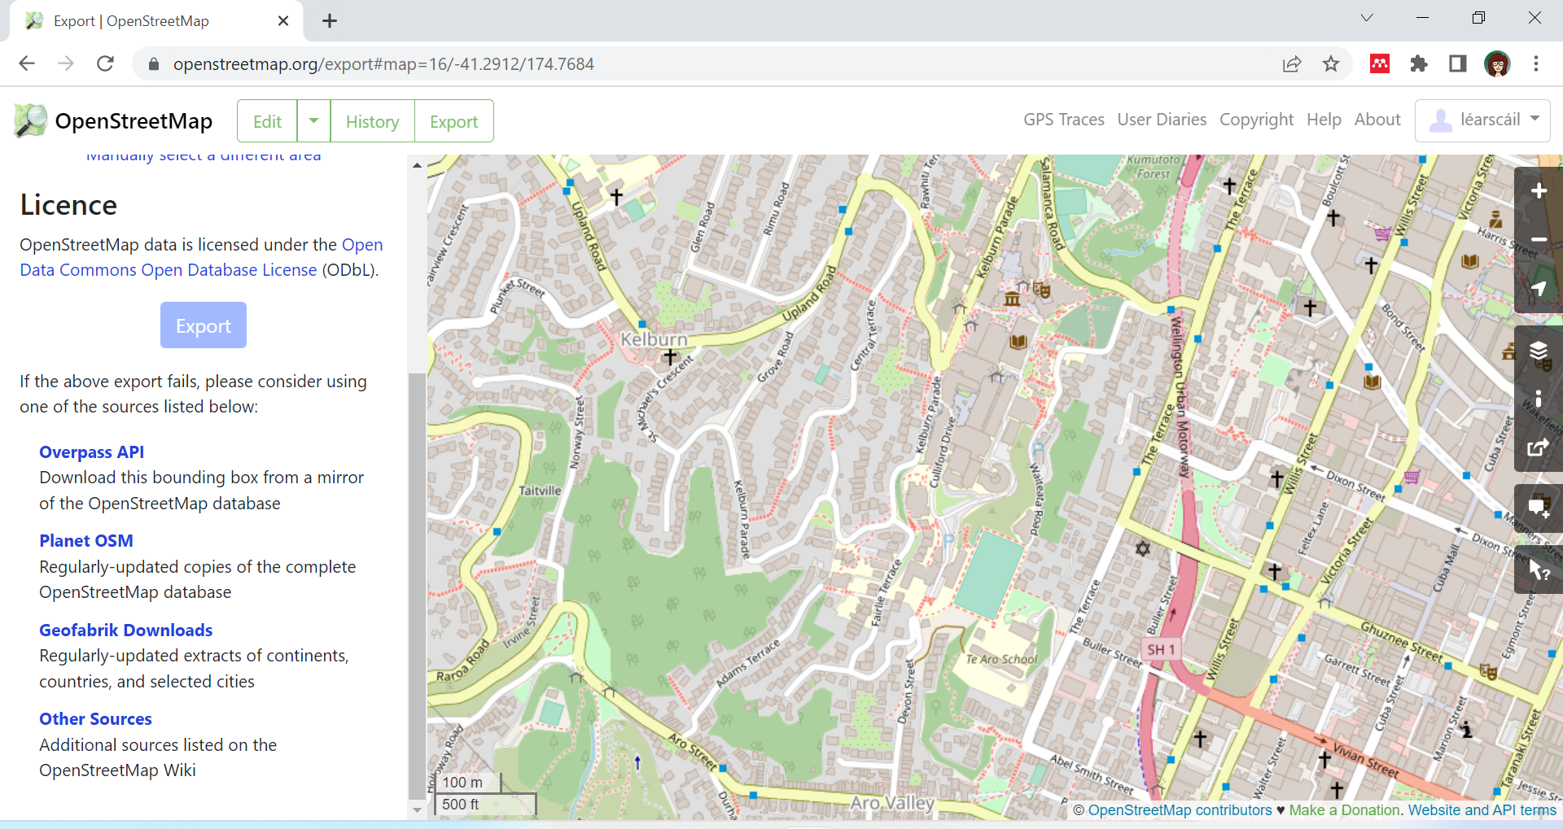

Slide 13
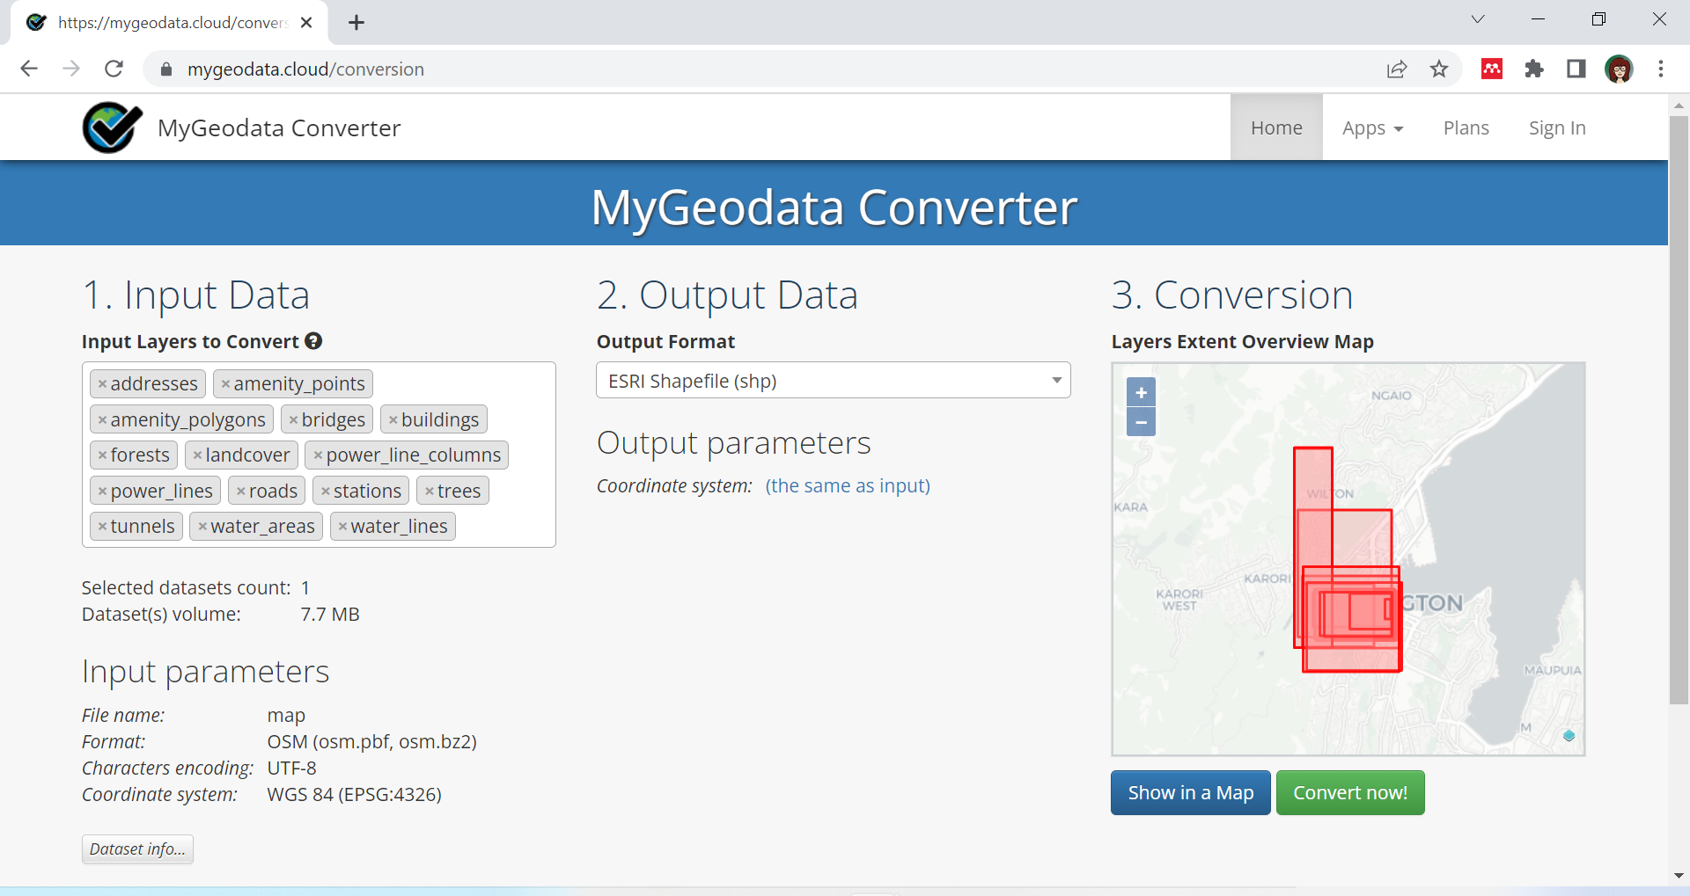

Slide 14
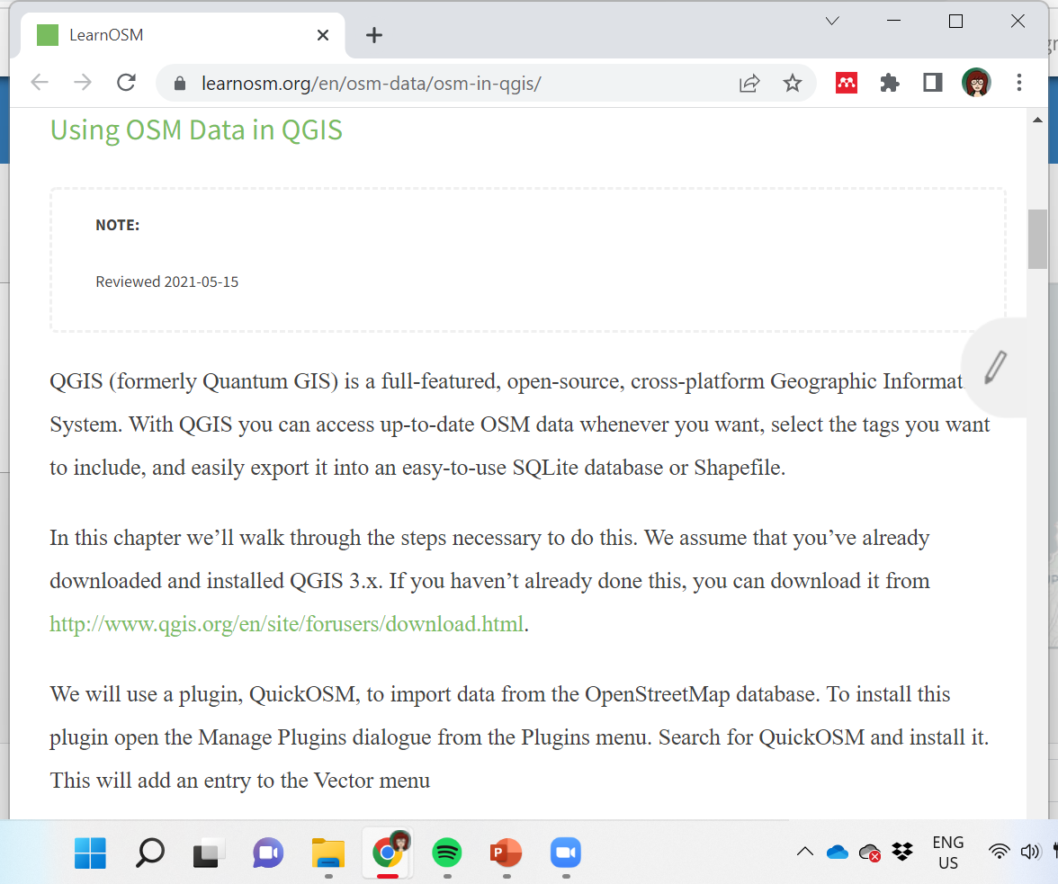
In QGIS install QuickOSM plugin
Add OSM as basemap (under XYZ Tiles)

Slide 15
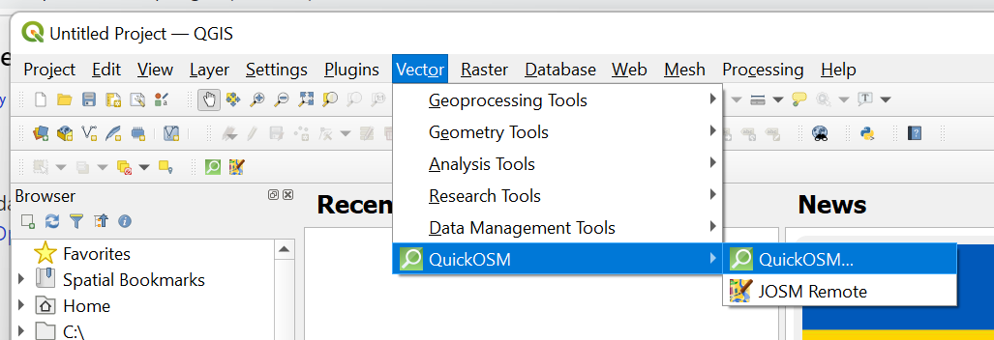

Slide 16
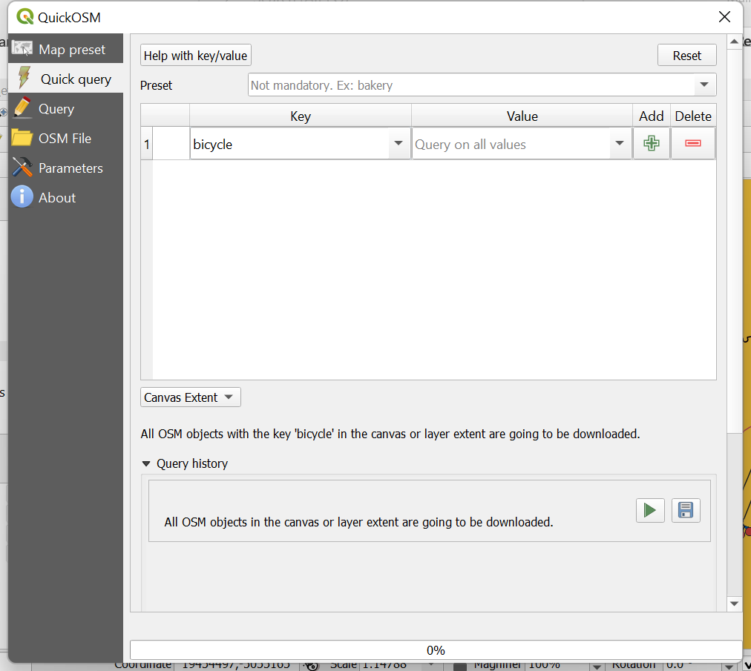

Slide 17
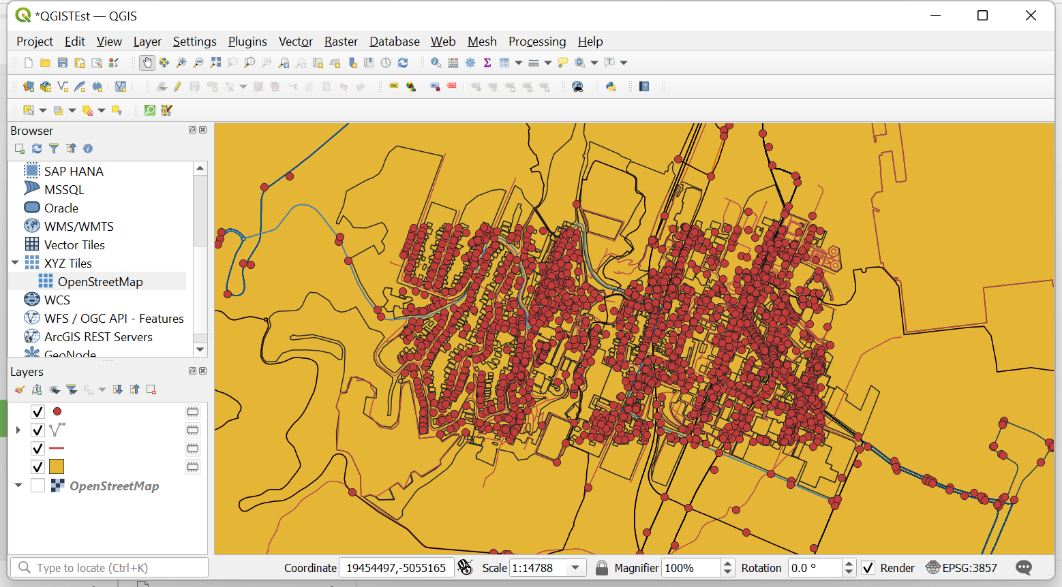

Slide 18
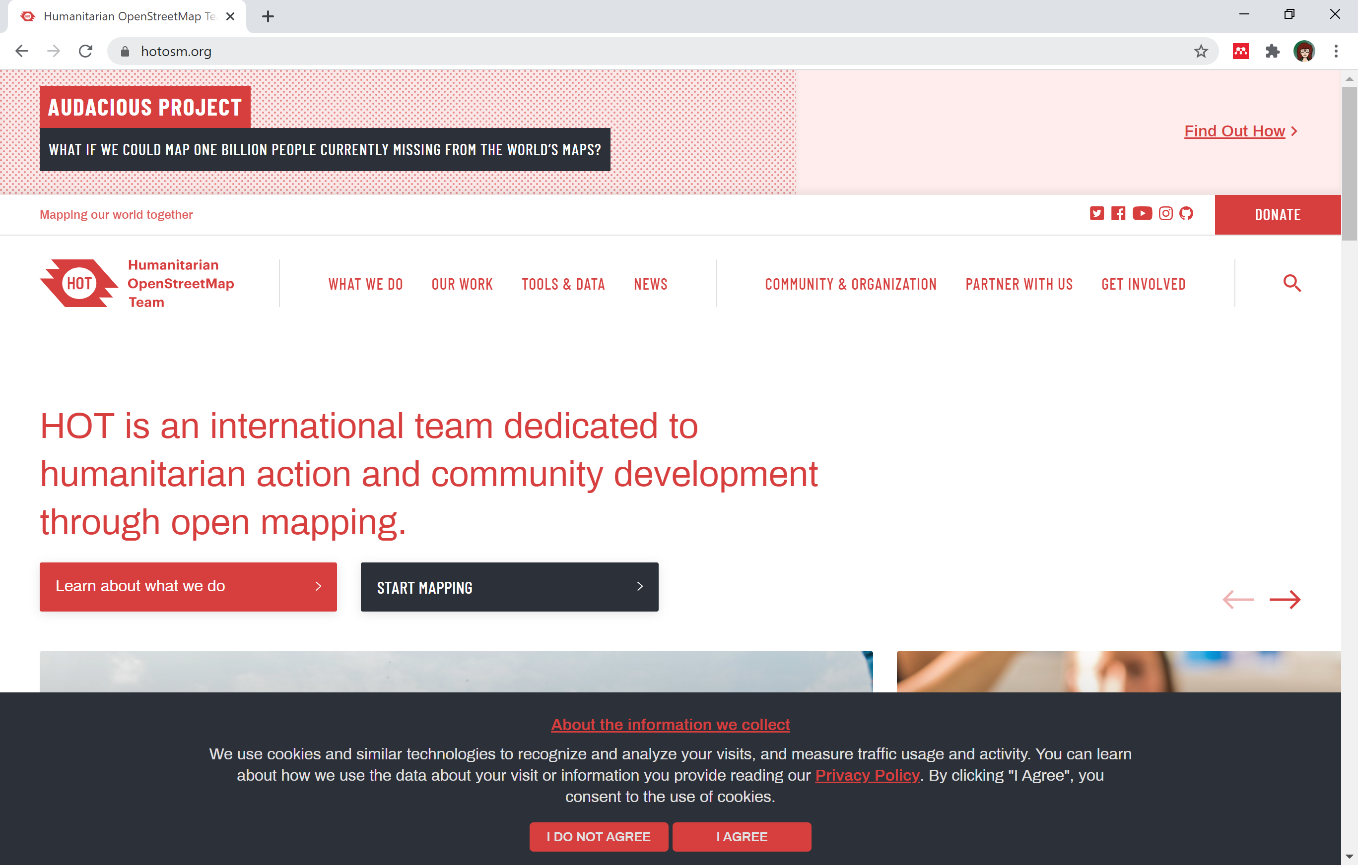

Slide 19
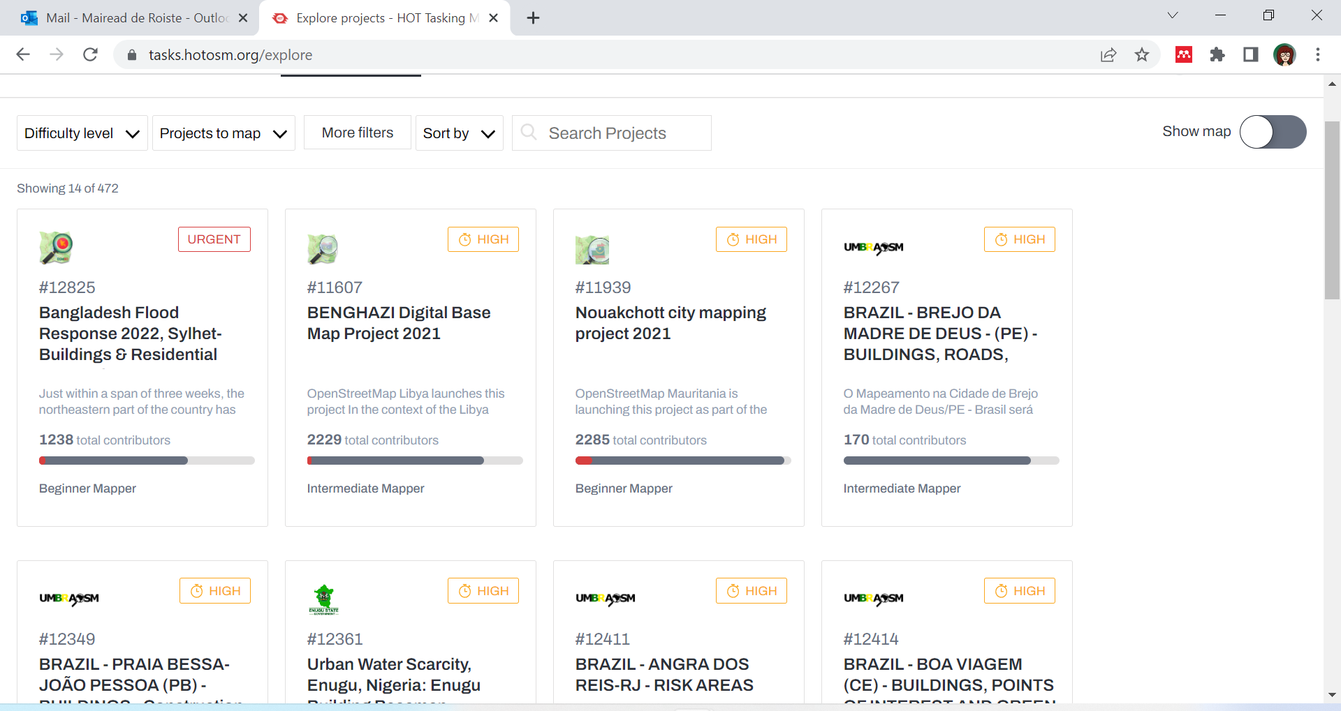

Slide 20
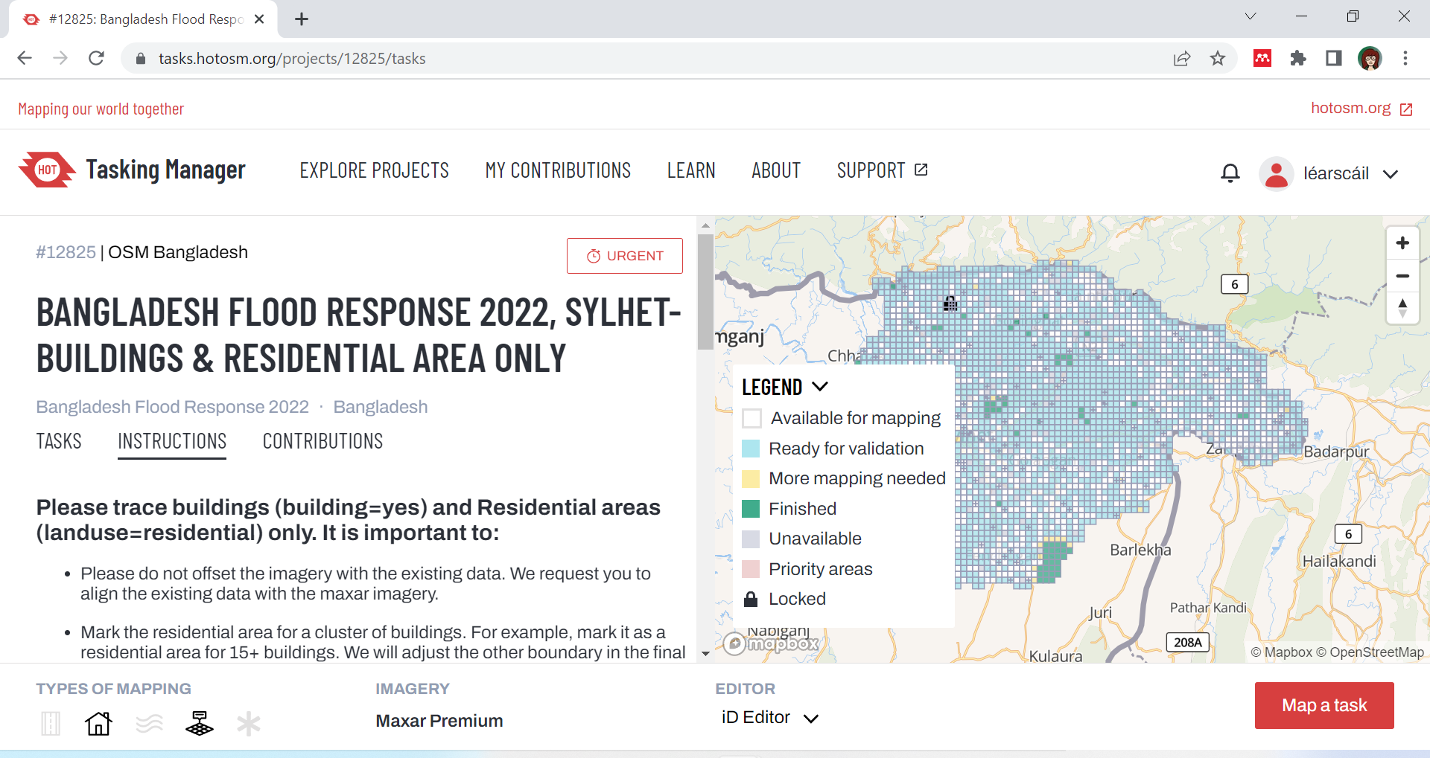

Slide 21
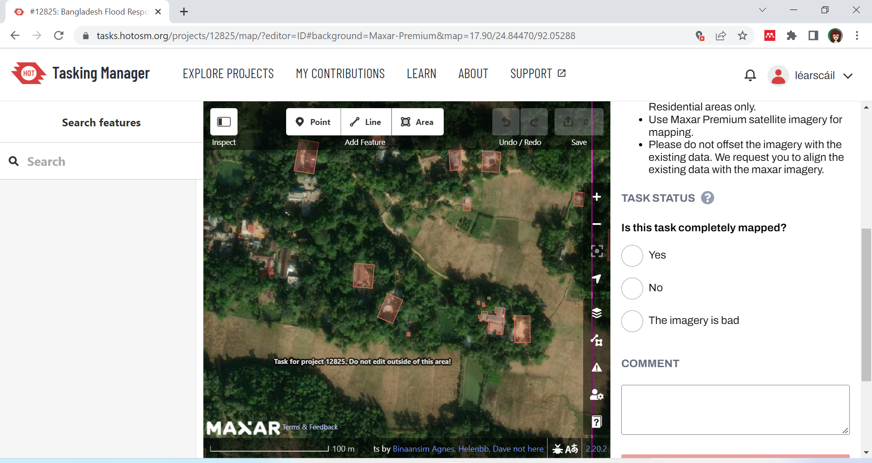

Slide 22
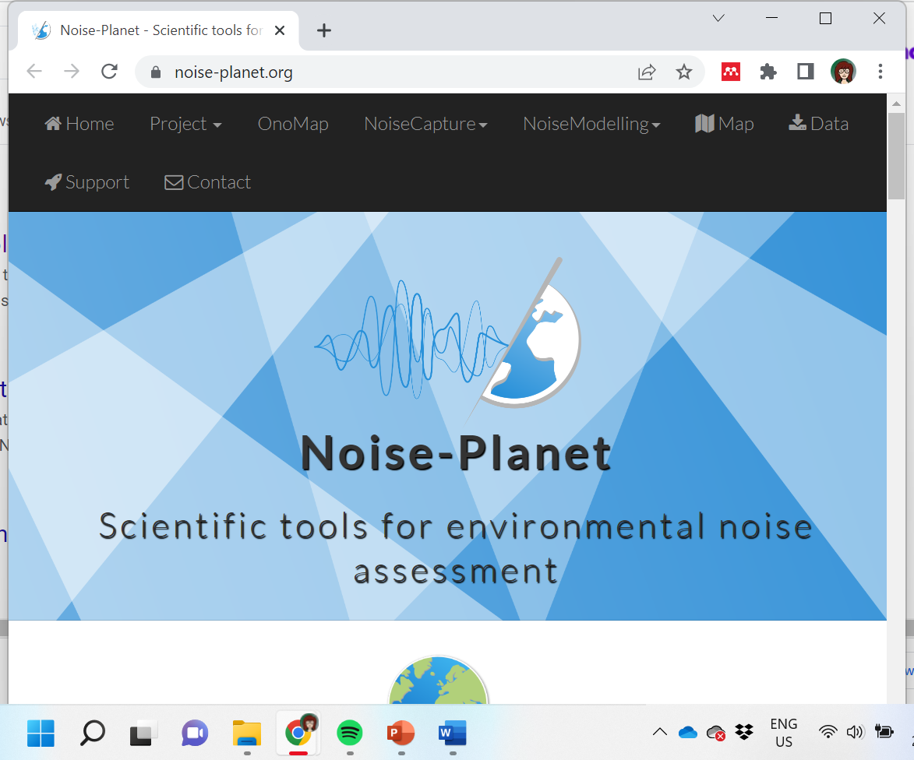
https://noise-planet.org/
Bocher et al. 2017, Collaborative noise data collected from smartphones, Data in Brief 14C (2017) pp. 498-503

Slide 23
